Slide 1
DEAL
Online Shop
SPRINT 1 SUMMARY

Slide 2
What we’ll discuss today?

Slide 3
01
SPRINT METRICS
02
06
TEAM
SPRINT 1 OBJECTIVES
07
MEMBER RETROSPECTIVE
03
SCRUM CEREMONIES
08
SCRUM MASTER RETROSPECTIVE
04
FLOW
09
FEEDBACK. QUESTIONS
05
APPLICATION CONFIGURATIONS

Slide 4


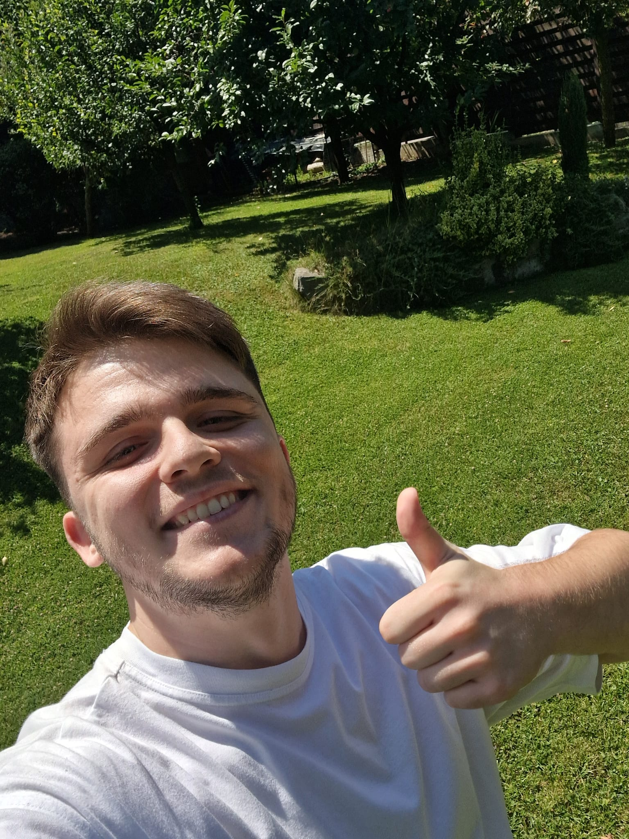
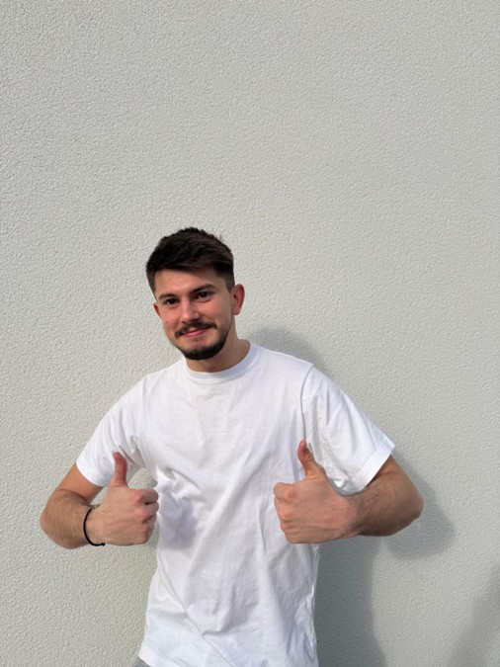

TEAM (HORIA BRENCHU)
Cristi
Andrei
Cornel
Gabriel
Hunor
Scrum master
FE Tech Lead
BE Tech Lead
FE Developer
BE Developer
QA Developer

Slide 5
02 SPRINT 1 OBJECTIVES
Set up the foundational project structure
Designed core database schema
Created architecture diagrams
Initialized automation framework
Identity service deployment
Discovery service integration
Gateway routing service setup
You can define one of the concepts here
You can define one of the concepts here
User sign-in and session handling
User sign-up with CRUD operations
Password recovery support
Role-based access control (RBAC)
Product search with filters
Product listing and management
For Admins:
Assign categories to sellers
Manage product categories (CRUD)

Slide 6
03 SCRUM CEREMONIES
🧭 1. Sprint Planning
Held at the start of each sprint
Team discusses what can be delivered and how the work will be accomplished
Stories are broken down into tasks and assigned story points
Output: a Sprint Backlog with a clear sprint goalCreated architecture diagrams
🗓️ 3. Stand-up (Daily Scrum *)
We tried to keep updated on Teams / WhatsApp
Each member answers:
What did I do yesterday?
What will I do today?
Are there any blockers?
Promotes transparency, team alignment, and quick issue detection automation framework
🔁 2. Backlog Refinement (Grooming)
Ongoing process during sprint
Ensures backlog items are clear, estimated, and prioritized
Helps the team stay ready for future sprints
🗓️ 4. Stand-up (Daily Scrum *)
Internal team meeting after the Sprint Review
Reflects on how the sprint went (not what was built)
Focus on process improvement:
What went well?
What didn’t?
What can be improved next sprint?
Output: concrete action items to enhance team performance

Slide 7
04 FLOW
1. 📖 Understand the Task
Read the Jira story and acceptance criteria
Confirm labels: FE, BE, Tech, etc.
Ask clarifying questions if needed (Slack, grooming, comments)
2. 🗓️ Create the Feature Branch
feature/DEAL-[JIRA-ID]/short-task-description
3. 🗓️ Create the Subfeature Branch
subfeature/FE/DEAL-[JIRA-ID]/short-task-description
subfeature/BE/DEAL-[JIRA-ID]/short-task-description
4. 🧱 Develop Your Feature
Implement based on story details
Commit often, clearly, and locally
UP TO DATE: feature into main, subfeature into feature
5. 🧪 Test the Feature
BE Unit tests
Manual test UI/UX
Validate with acceptance criteria
Update coverage if required
7. 📝 Create Merge Request (Subfeature → Feature)
🔖 Name: [Subfeature][FE][DEAL-1234] - Add login form
✅ Review with team
✅ Wait for approval
8. 📝 Final merge request for feature after integration)
9. 📝 Make automation feature for QA testing

Slide 8
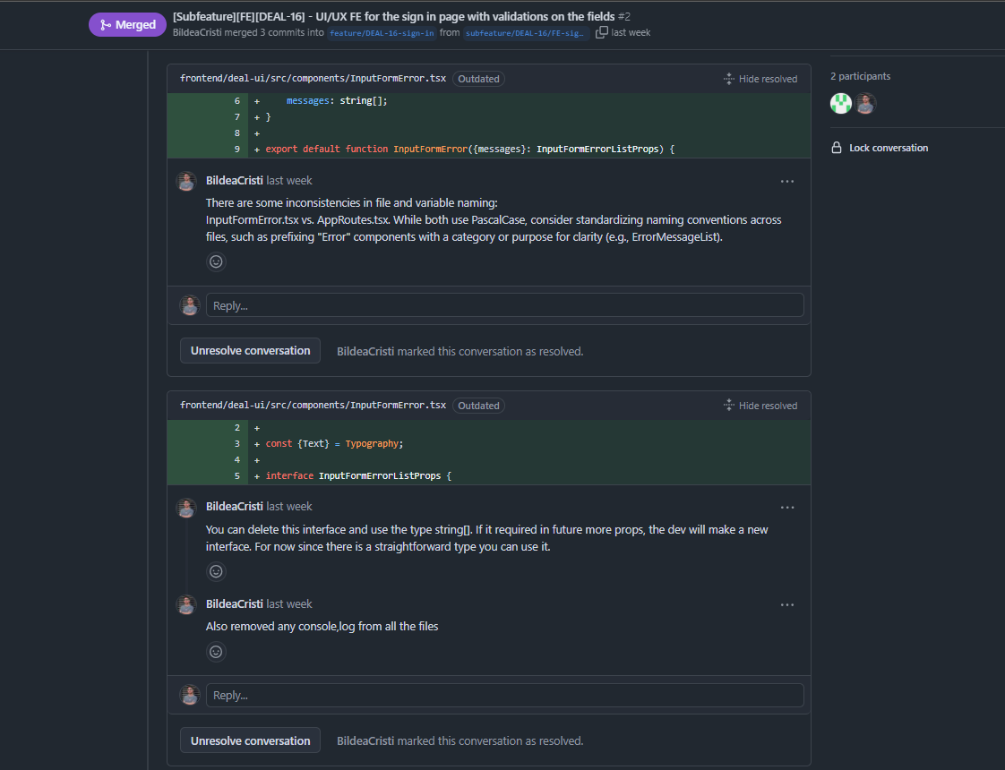
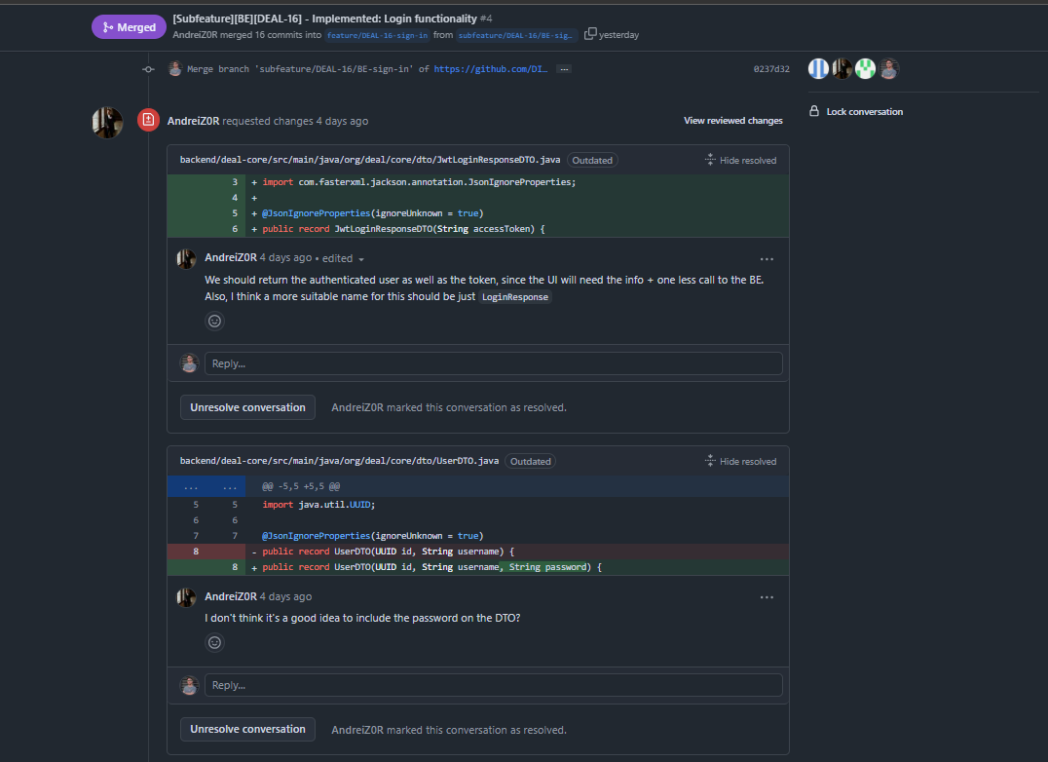
04 FLOW

Slide 9
05 APPLICATION CONFIGURATIONS
Frontend
Ant Design + Custom Theming
Enterprise UI components with custom theme system for consistent, responsive, and beautiful interfaces across all devices.
Error validations
Input validation with real-time feedback, also handling of messages with a snackbar (success, error, warning, info) can be used for notifications also.
Redux Toolkit + React Query
Dual state management: Redux for client state (auth) and React Query for server state, ensuring efficient data handling and real-time updates.
TypeScript + React 18
Type-safe development with modern React features, providing better error prevention and improved code maintainability.
JWT + HTTP-only Cookies
Secure authentication with protected routes and role-based access, ensuring safe user sessions and data protection.
React Hook Form + AntD Rules
High-performance form handling with schema validation, delivering smooth user experiences with minimal re-renders.
• Component Architecture
Modular, reusable components with card-based design, ensuring consistent UI/UX and code maintainability.
Backend
Spring Boot + Spring Security
Robust Java framework with built-in security features, providing scalable and secure RESTful API endpoints with JWT authentication.
PostgreSQL Database
Reliable relational database with advanced features for data integrity, transactions, and complex queries in the e-commerce system.
JPA/Hibernate
Object-relational mapping framework enabling efficient database operations, entity management, and data persistence.
Spring Data JPA
Simplified data access layer with automatic repository implementations and query generation for faster development.
Spring WebFlux
Reactive programming support for handling asynchronous operations and non-blocking I/O operations.
Lombok
Reduces boilerplate code with annotations for getters, setters, and constructors, improving code readability.
Spring Boot Actuator
Production-ready features for monitoring and managing the application, including health checks and metrics.
Reactive Gateway & Automatic Service Discovery under Docker
Automation
Selenium WebDriver
Automated browser testing framework for end-to-end testing of web applications, ensuring UI functionality and user interactions.
•Page Object Model (POM)
Design pattern for organizing test code, separating page-specific code from test logic, enhancing maintainability and reusability.
•TestNG Framework
Testing framework for organizing and executing tests, supporting parallel execution, data-driven testing, and reporting.
•Maven
Build automation tool for managing project dependencies, compiling code, and running tests, ensuring consistent build processes.

Slide 10
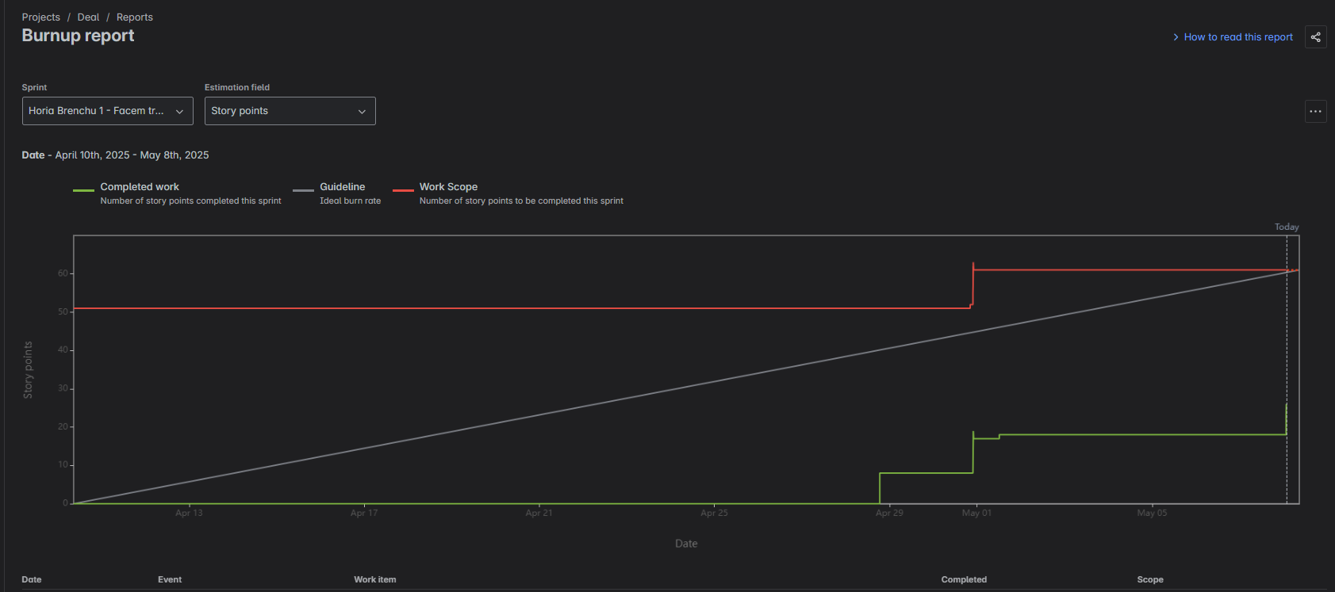
06 SPRINT METRICS

Slide 11
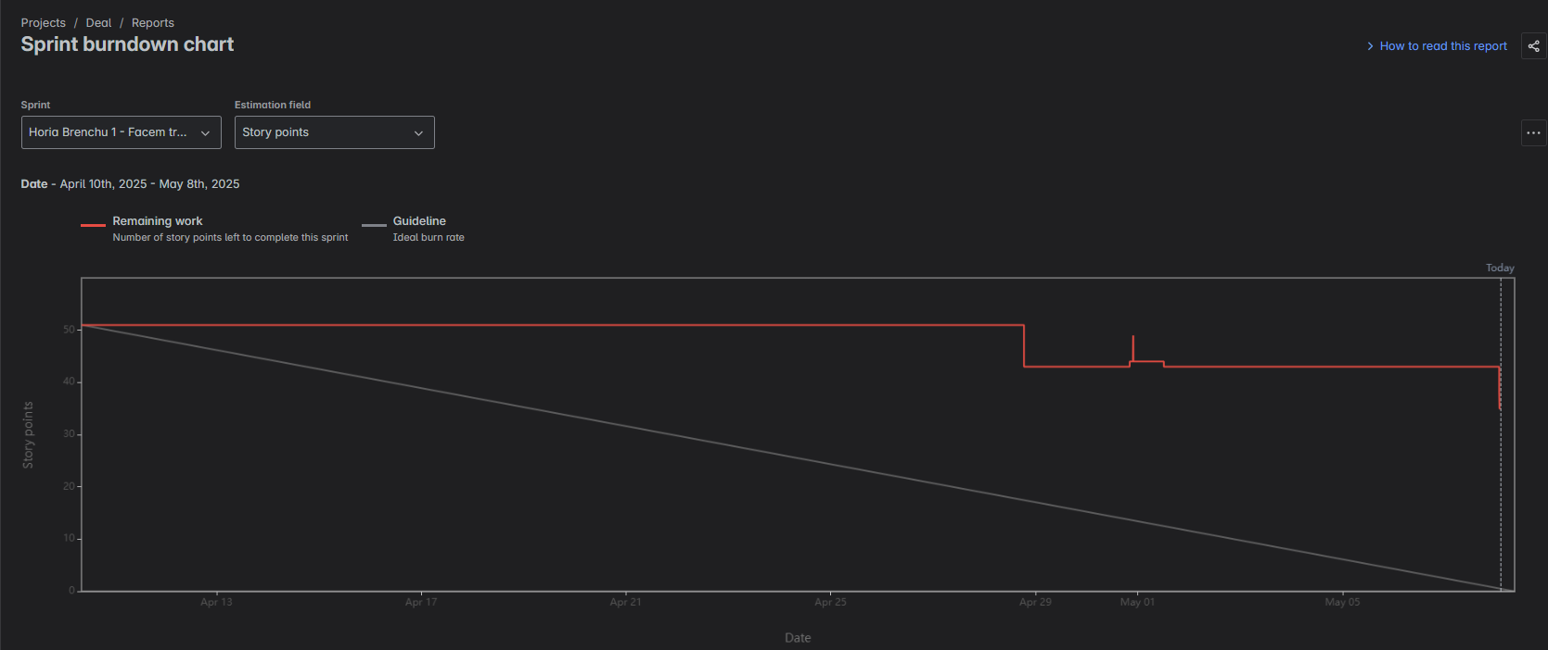
06 SPRINT METRICS

Slide 12
06 SPRINT METRICS

Slide 13
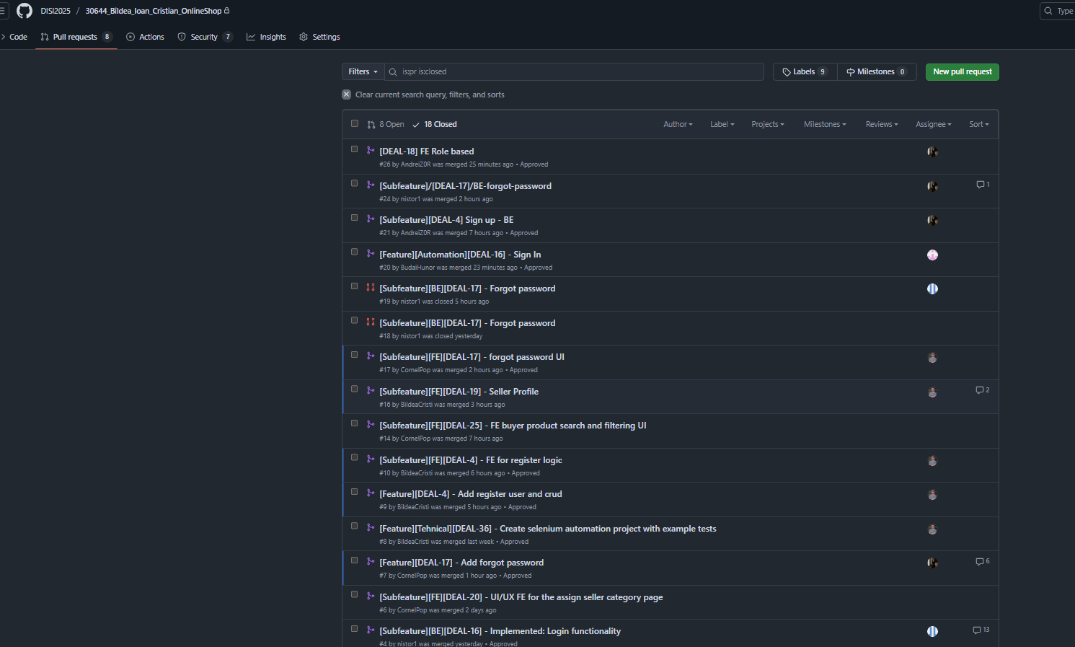
06 SPRINT METRICS

Slide 14
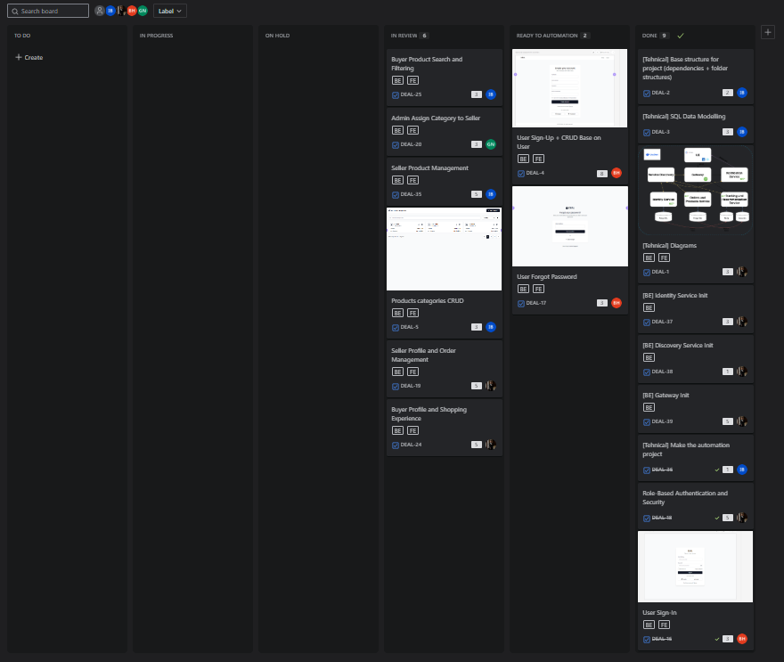
06 SPRINT METRICS

Slide 15
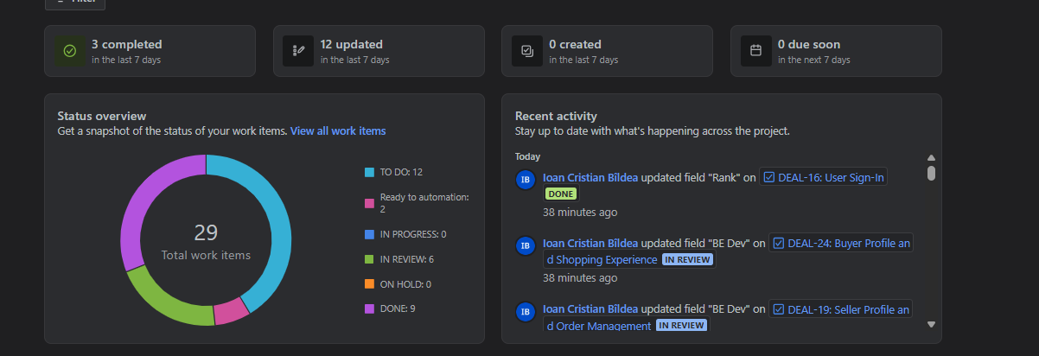
06 SPRINT METRICS
There were 29 work items in the sprint:
9 DONE (100%)
2 READY TO AUTOMATION (There are dev done, only QA test needed) (95%)
6 IN REVIEW (DEV (BE or FE Done, only 60%, 80& DONE) (60&-80%)
0 ON HOLD
0 IN PROGESS
The resolution it is that the we could not finish the sprint work items, but we are optimistic for the next sprint because the base of the backend/frontend/automation projects are on point and the next feature and remaining ones will be done quicker.
Also, the integration of the members of the team with the technology, git, workflow will be improved.

Slide 16
07 MEMBER RETROSPECTIVE Andrei

Slide 17
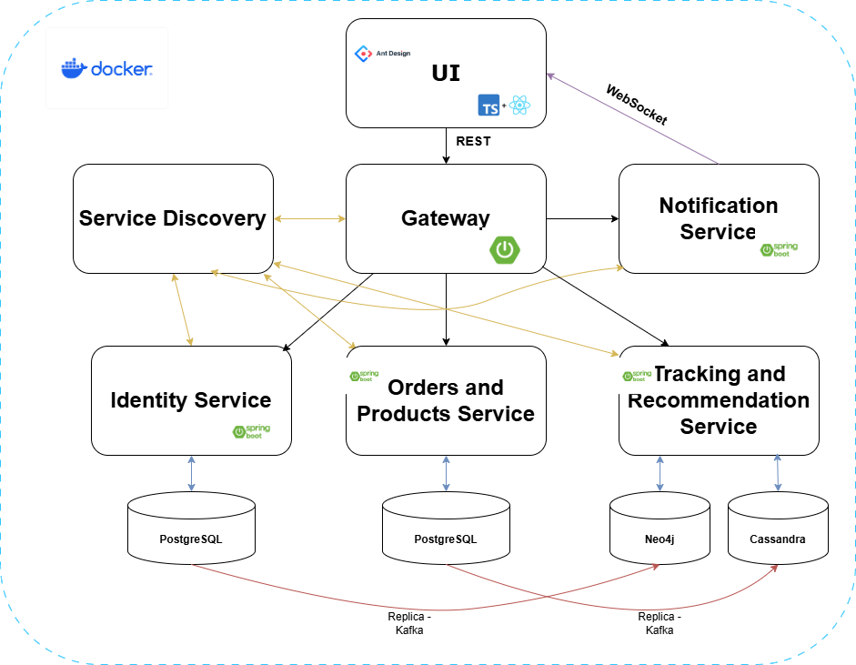
Andrei Borza – Dev life
Completed tasks:
App architecture and diagrams
Service Discovery (Netflix Eureka), Gateway (Reactive) & Identity Service (layered) structure, DB & Mail Server dockerization, Core project for transfer objects & services commons as well as a custom HTTP Client for internal use
Checkstyle & code coverage validations & runbooks
Registration, Auth Filter, User CRUD & Role based auth
Exception handling & response uniformization
Code review & Bug fixing & Technical Improvements
Technical Implementation:
Running up a PostgreSQL DB configured to be plug and play
for each teammate
Containerized mail server
Unit tests base configurations & helpers, kept the code
base on a 94% total instruction coverage
Requests & Response validations

Slide 18
Andrei Borza - Retrospective
What went well:
Regular meetings & check-ups, if anyone had a problem someone was there to help
Managed to (almost) finish the work expected
What was challenging:
Too much time spent on support, reviews and fixing rather than developing
Giving “tutorials” for git, branching, merging, rebasing
What can be improved:
Branch chaos, not enough attention on updating branches, parts of code
changed and/or accidentally lost -> do it again…
Relying too much on AI, parts of the reviewed code were not even
compiling, no attention to details whatsoever
When something is ready for review, I expect it to be working not
half-baked and needing a do-over
Deviating from agreed architecture/implementation is not great,
as we have discussed something and reviewed something completely
different

Slide 19
07 MEMBER RETROSPECTIVE Cornel

Slide 20
What I did for the team
I worked on the Frontend part of our application delivering next tasks:
Login Screen
Forgot Password Screen
Dashboard (Buyer Screen)
Product Management (Seller Screen)
Product Categories Management (Seller Screen)
Implemented tasks using a modular React component-based architecture, designing and validating reusable components to ensure maintainability and scalability.

Slide 21
In retrospect
Everything went smoothly during the sprint; I completed my planned tasks on time.
If I could change one thing, I would dedicate more time studying the documentation of the library we used.
One challenge for me was working with the AntD library, which required additional time to understand.
I consider our strong point the communication that we maintained during the sprint.

Slide 22
07 MEMBER RETROSPECTIVE Gabriel

Slide 23
Nistor Ioan-Gabriel
Completed Tasks: I have implemented the login functionality, the forgot password flow CRUD operations for product categories and Unit tests.
Technical Implementation:
Login: Implemented using Spring Security with JWT token generated after successful authentication with AuthenticationManager.
Forgot Password: A secure reset token is generated and stored with an expiration date and an email with a reset link is sent using JavaMailSender.
Product Microservice setup and CRUD for Product Categories: Built using a layered architecture (Controller -> Service -> Repository), with DTO mapping and validation on create and update operations.

Slide 24
Nistor Ioan-Gabriel
What went well: Team communication was effective, which helped us stay aligned throughout the sprint and resolve tasks efficiently.
We supported each other through regular meetings and group communication, which helped us stay organized and make steady progress during the sprint.
Challenge faced: One of the main challenges was resolving merge conflicts when integrating multiple branches.
Improvements: We could improve our workflow by updating feature branches with changes from main more frequently to minimize future conflicts.

Slide 25
07 MEMBER RETROSPECTIVE Hunor

Slide 26
Budai Hunor
Completed Tasks: I have implemented automation testing for the Log In process.
Technical Implementation:
Implemented using Selenium WebDriver to create three automation tests.

Slide 27
Budai Hunor
What went well: Team work was efficient, which improved the workflow, and communication was also effective because of the group meetings.
Challenge faced: One of the main challenges working with the project’s complex structure.
Improvements: Having more readme files or comments in the code with explonations.

Slide 28
08 SCRUM MUSTER RETROSPECTIVE Cristi

Slide 29
What I did for the team
I worked as Scrum Master managing team progress and also on the FE part of our application delivering next tasks:
SQL Data Modelling
FE project init and configuration for AntD UI library, theme config, redux, error handling, integration config with React Query, etc.
Automation project init & setup
User Sign-Up
Seller Profile and Order Management
Seller Profile and Shoping Experience
Reviews
DEV Suport
On the other task integrations, bug fixing

Slide 30
In retrospect
I tried my best to manage this team and offer guidance for all my teammates.
We could finish this sprint only by reducing the code standards, be more aware of the basic workflows and deadlines that we agreed.
The dev support it took me more time than developing.
I am proud of the result, the level of our code standard and the workflow created.
I should be made more daily meetings to check of the members and have specific deadlines.
I think we should be more committed in the next sprint based on the deadlines so we can finish also the rest of this sprint.

Slide 31

THANKS!
09
FEEDBACK. QUESTIONS

